Slide 1

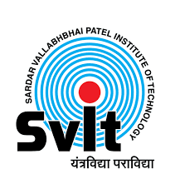
Sardar Vallabhbhai Patel
Institute Of Technology
Project Management System
Prof. Divya ma’am
Prepared By : Darsh Shah
(200410107104)
Assistant Professor,
Computer Engineering Department
SVIT, Vasad

Slide 2
OUTLINE
Company Overview
Abstract
Introduction to Internship
Objective
Tools and Technologies
Estimated time of completion
System Design
Conclusion & Future Work

Slide 3
1. Company Overview
Name: Grownited private limited.
Technologies: Web Developers, Mobile App Development, E-Commerce Development, Software Development.
Time: 9:00 AM to 6:00 Pm
Address: 301-305, 3rd Floor, Surabhi Complex, Nr. Municipal Market, Chimanlal Girdharlal Road, Navrangpura, Ahmedabad, Gujarat - 380009

Slide 4
2. Abstract
The final year report investigates the application of a project management system developed to facilitate communication between managers and developers, streamlining workflow processes. This system enables managers to assign tasks to developers, create projects, project modules, and tasks, and allocate them to the development team. By focusing on the functionalities of this project management system, the report emphasizes its role in enhancing collaboration, task allocation, and project organization within a team environment. Through practical implementation and analysis, the report demonstrates the system's efficiency, scalability, and flexibility in managing and tracking project progress effectively. By showcasing real-world examples and best practices, this research aims to offer valuable insights for professionals looking to optimize project management and communication workflows in their organizations.

Slide 5
3. Introduction to Internship
The internship kicked off with an orientation session that outlined the objectives and expectations of the program.
This session introduced the different modules and courses that would be covered during the internship, setting a clear foundation for the tasks ahead.
As I progressed through the internship, I actively participated in completing assigned modules and projects related to Python and Django for web development.

Slide 6
4. Objective
The objective of this project management report is to offer insights into the best practices and strategies for managing web application projects using Python and Django.
The report aims to analyze project management approaches, tools, and techniques tailored to the specific needs of web application development.
It seeks to identify key project management skills and methodologies essential for successful project delivery in the Python and Django environment.

Slide 7
Furthermore, the report will provide recommendations for project managers on effective project planning, execution, and monitoring within the context of web application development.
By conducting this analysis, the report aims to bridge the gap between project managers and developers in the web application domain.
It will offer valuable insights to project managers, enabling them to identify and implement the most effective project management practices for Python and Django projects.
Simultaneously, it will empower developers with a comprehensive understanding of project management principles and strategies crucial for successful project completion in web application development.

Slide 8
5. Tools and Technologies
For Frontend: Python, HTML, CSS
For Backend: Django
For Database: PostgreSQL

Slide 9
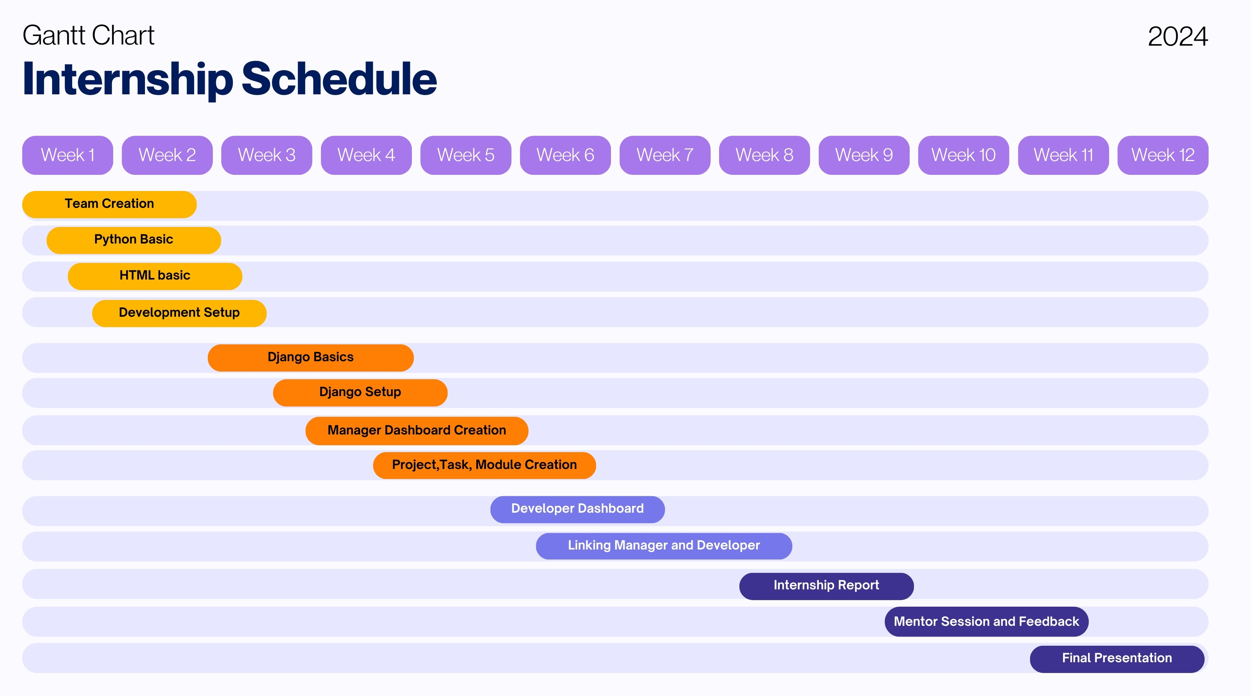
6. Estimated time of completion

Slide 10
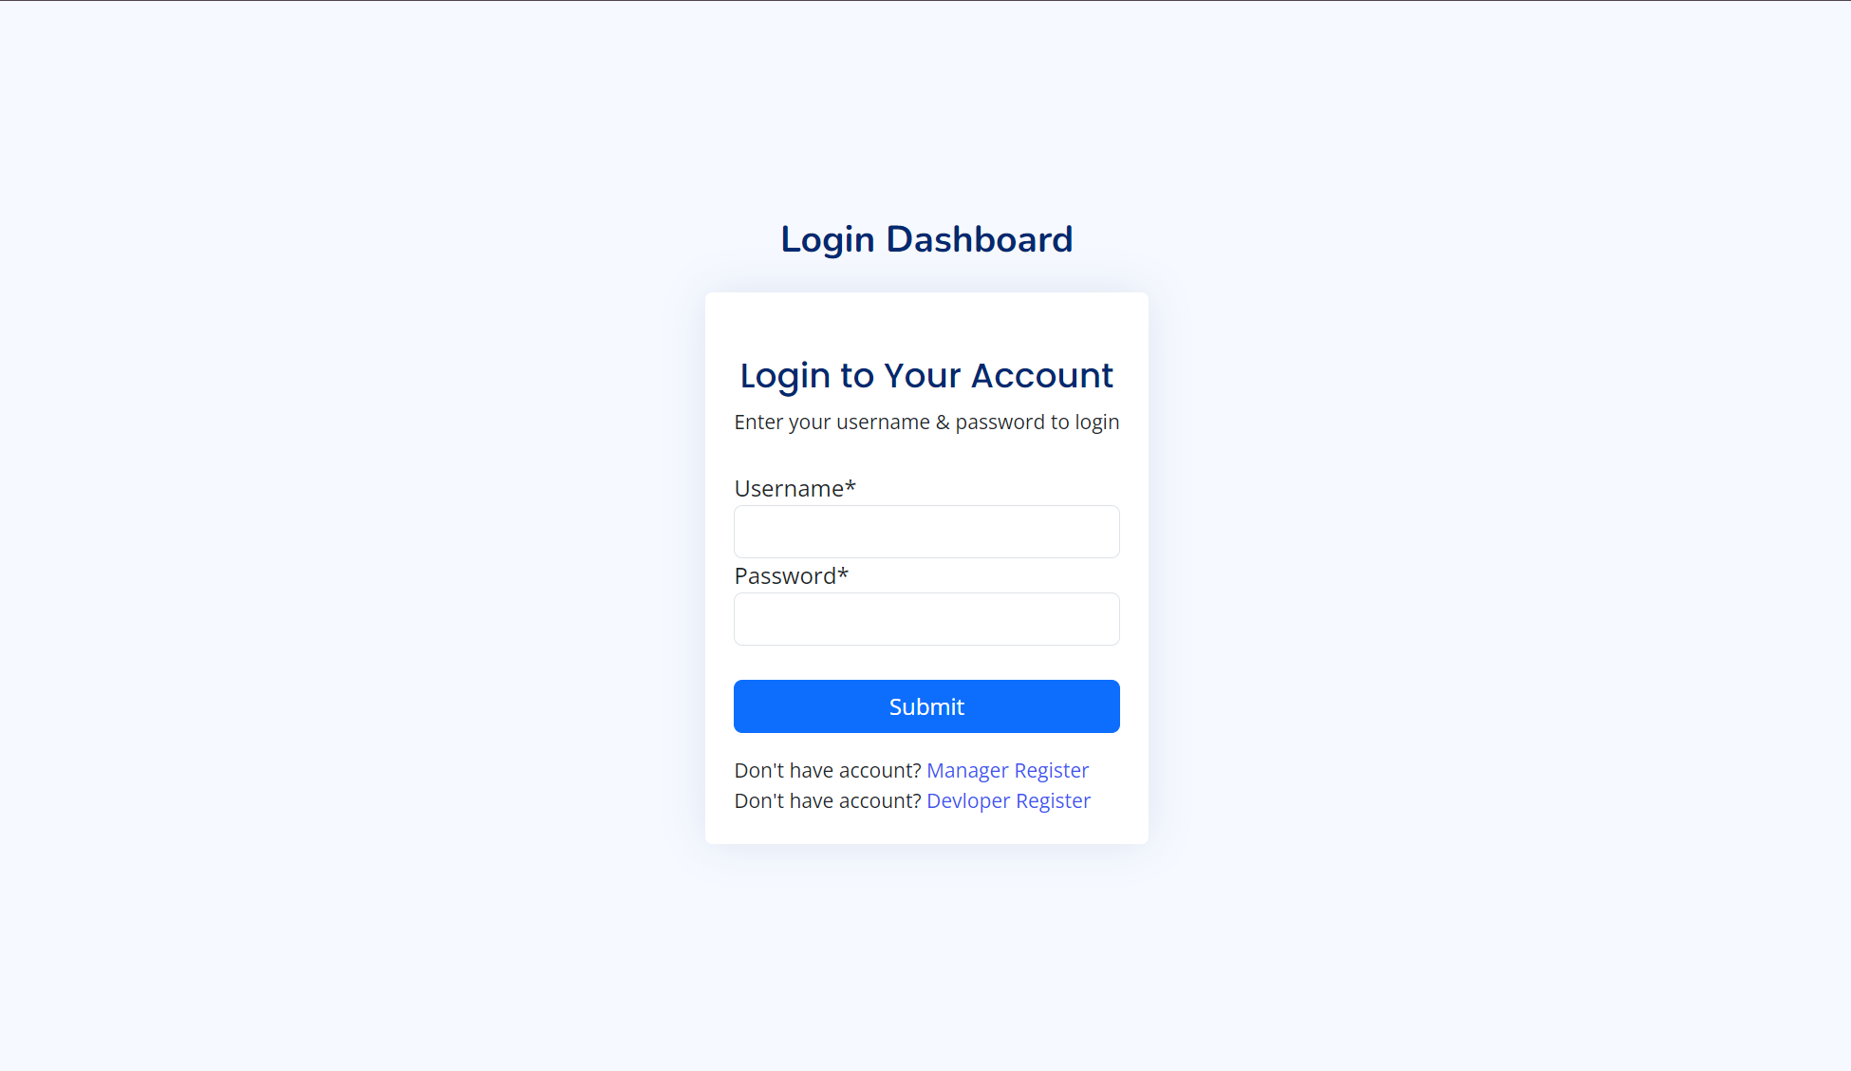
7. System Design
Login Dashboard

Slide 11
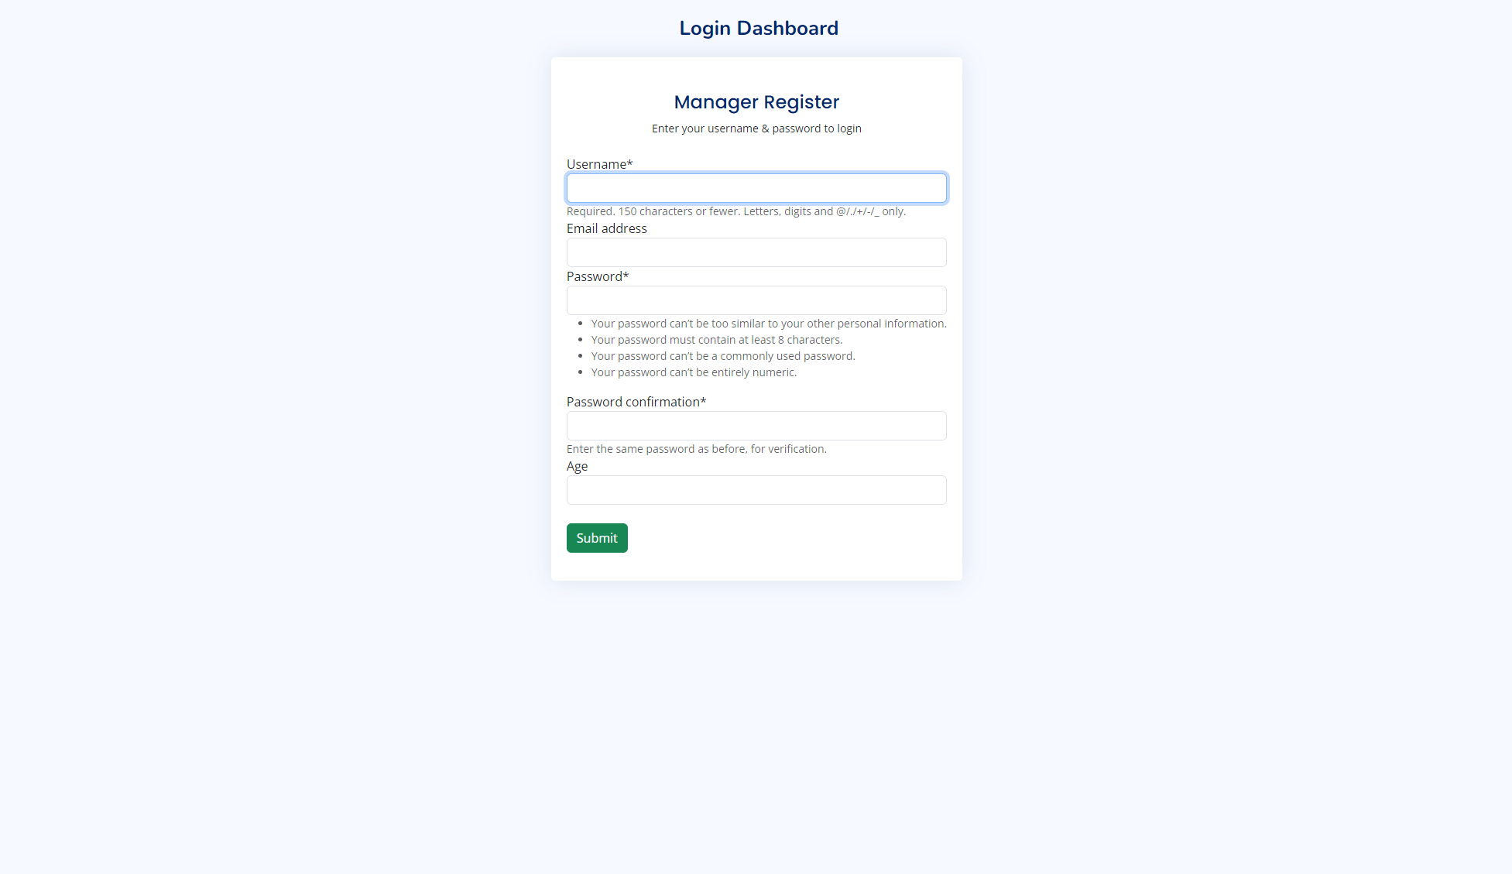
Manager Register

Slide 12
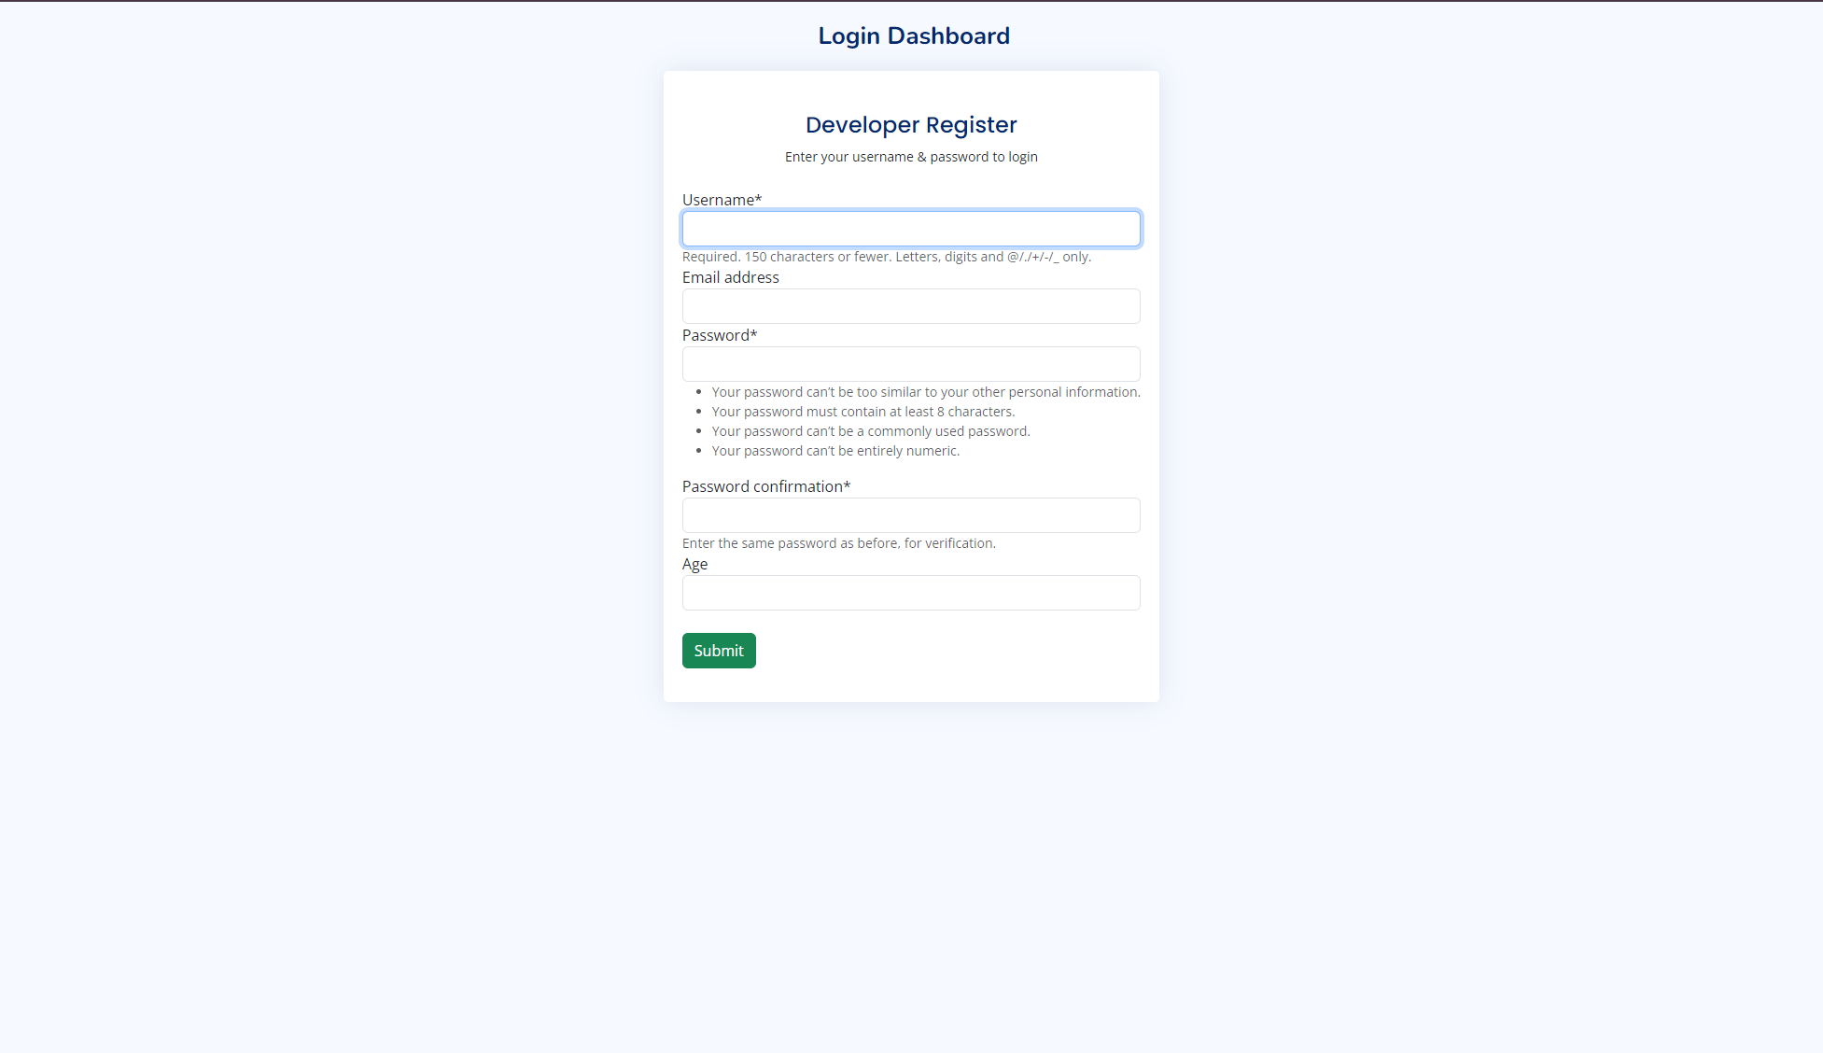
Developer Register

Slide 13
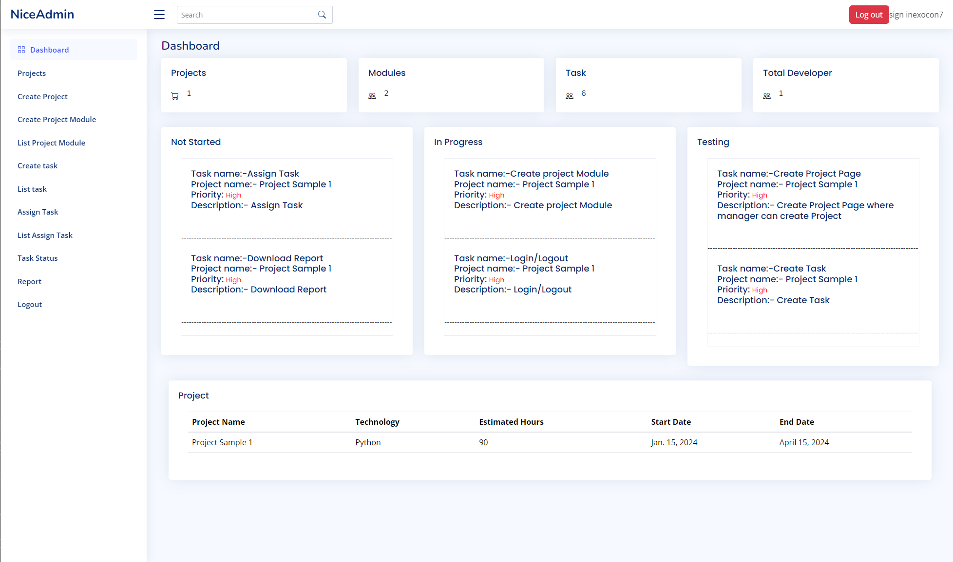
Manager Dashboard

Slide 14
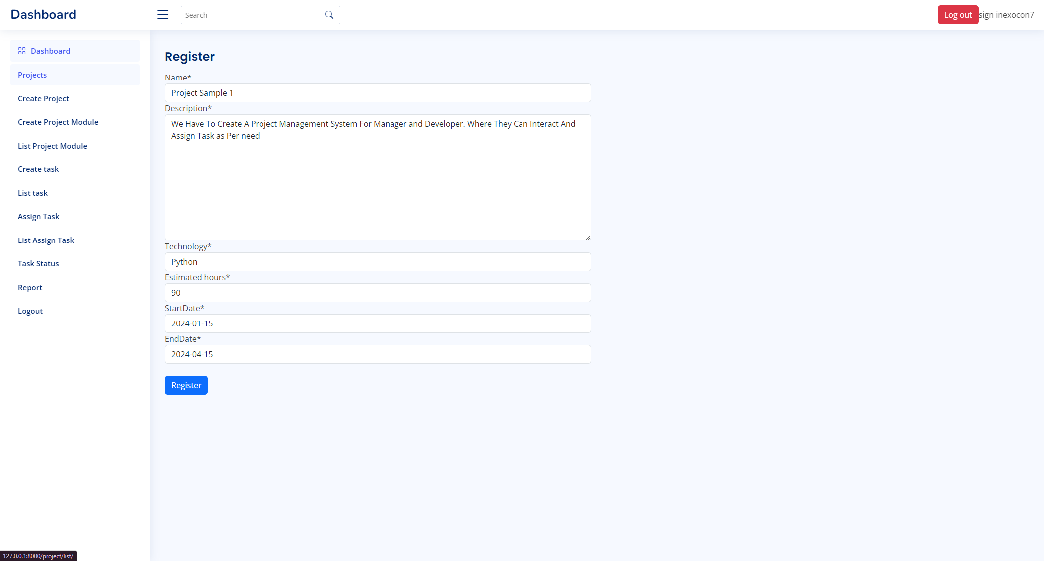
Project Creation Module

Slide 15
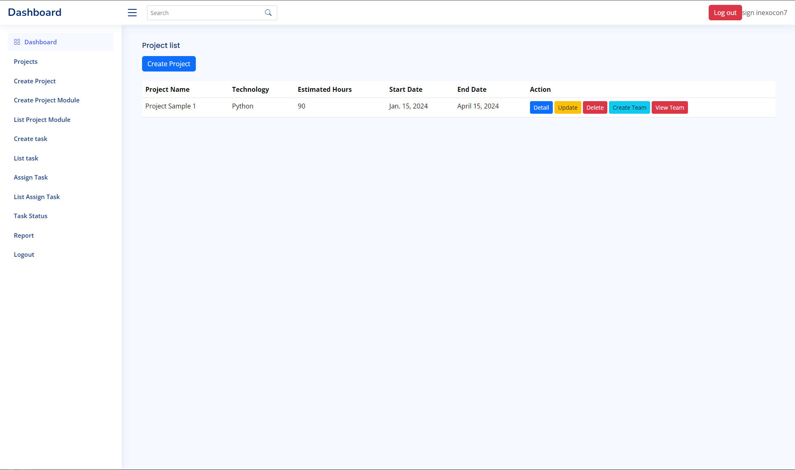
Project list

Slide 16
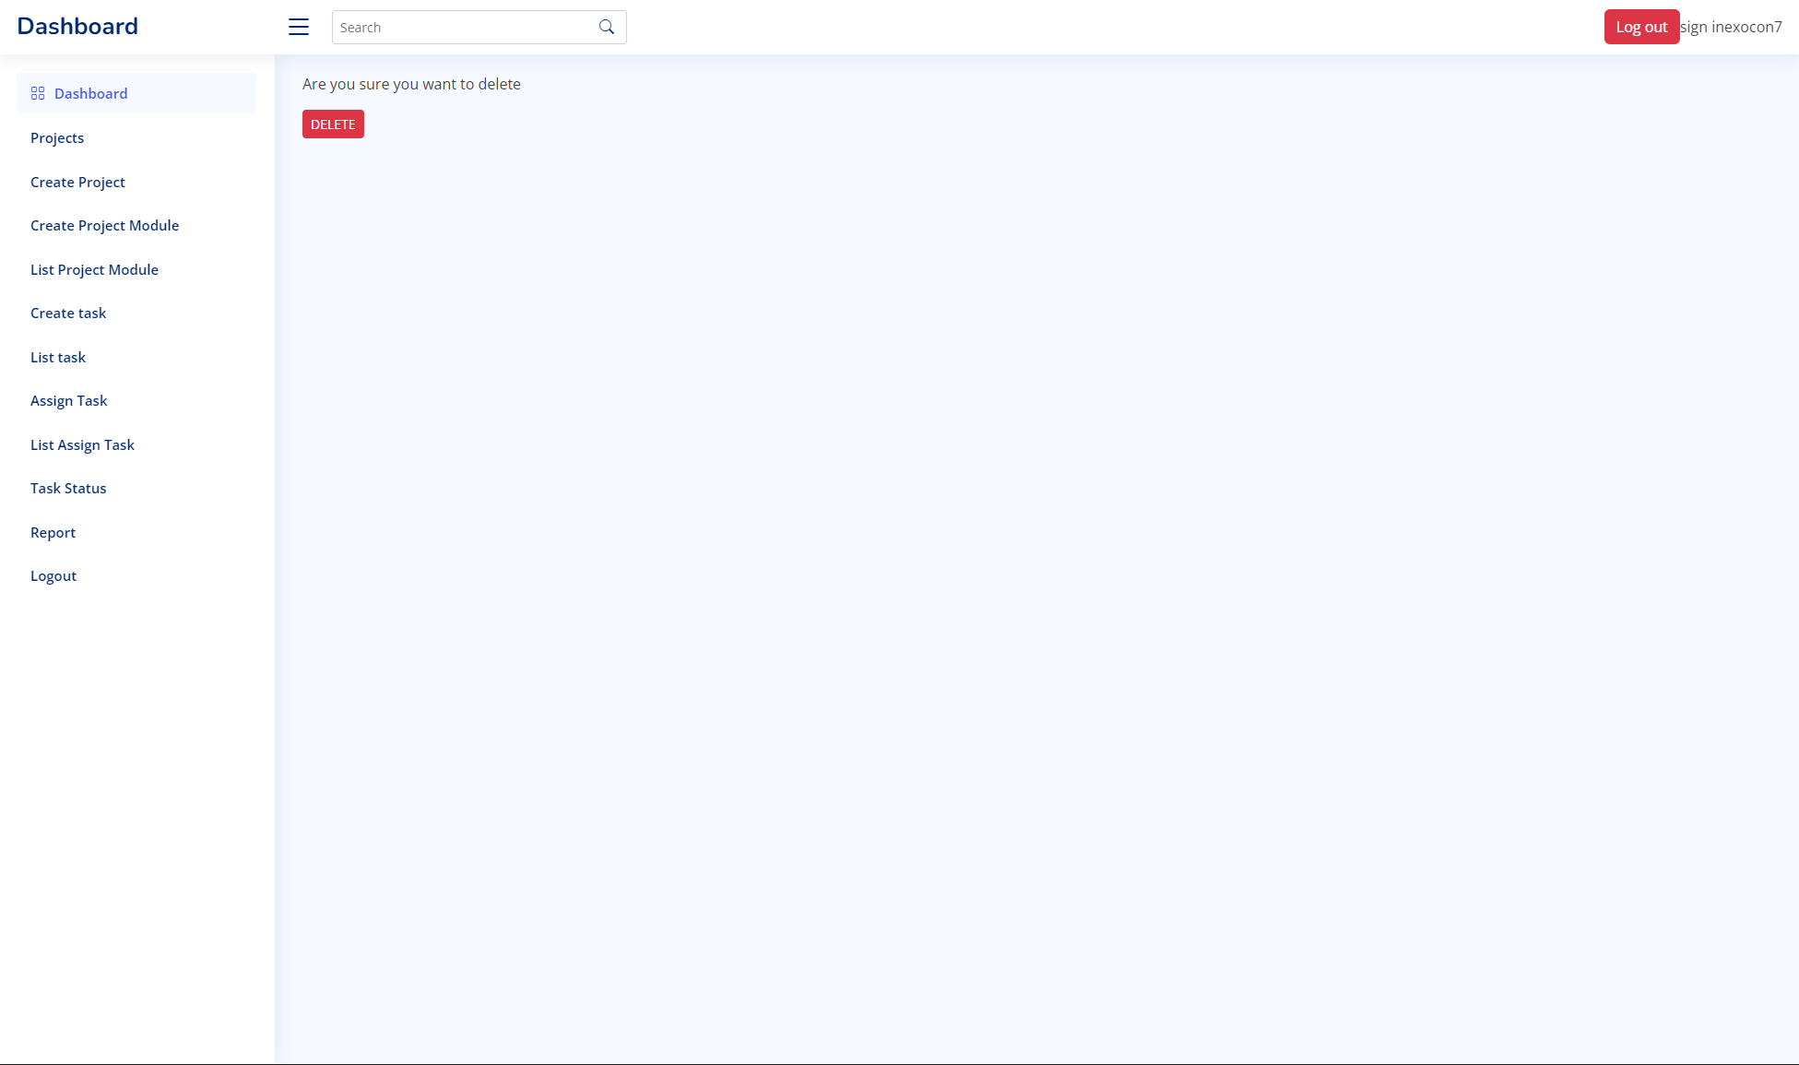
Project Delete Module

Slide 17
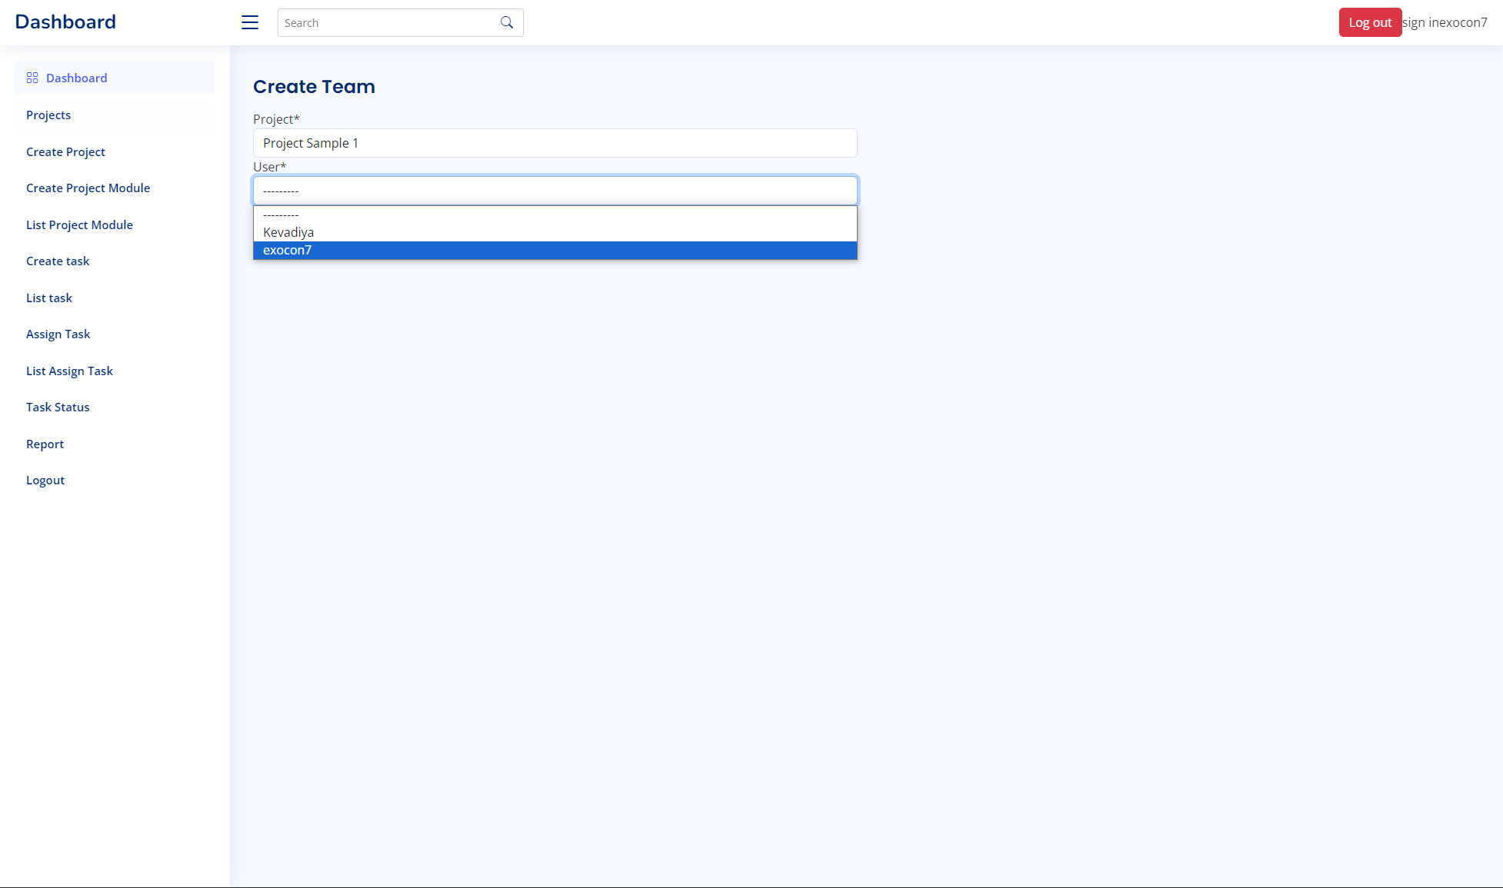
Team Creation Module

Slide 18
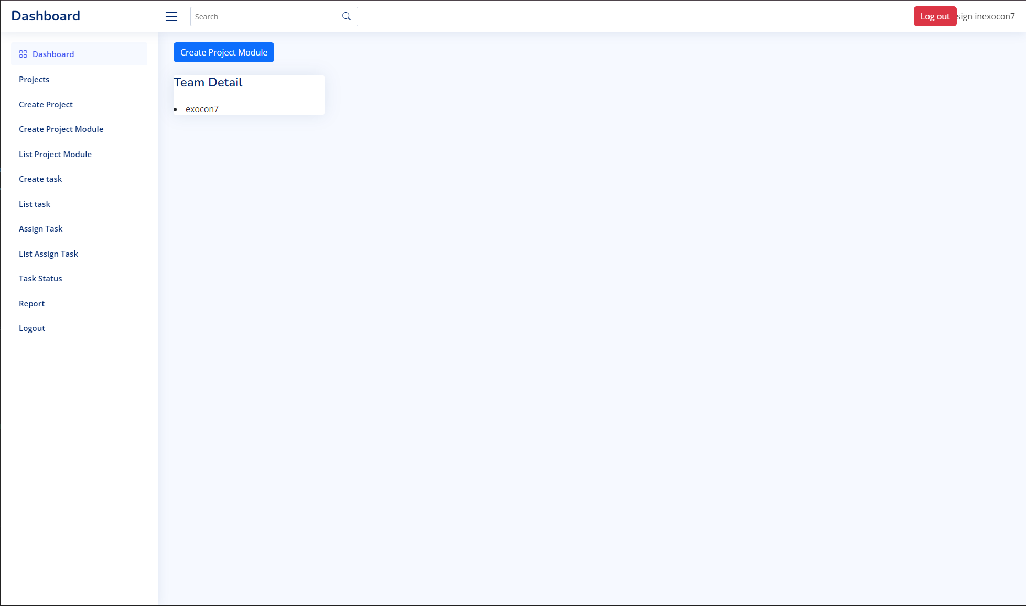
Team Detail Module

Slide 19
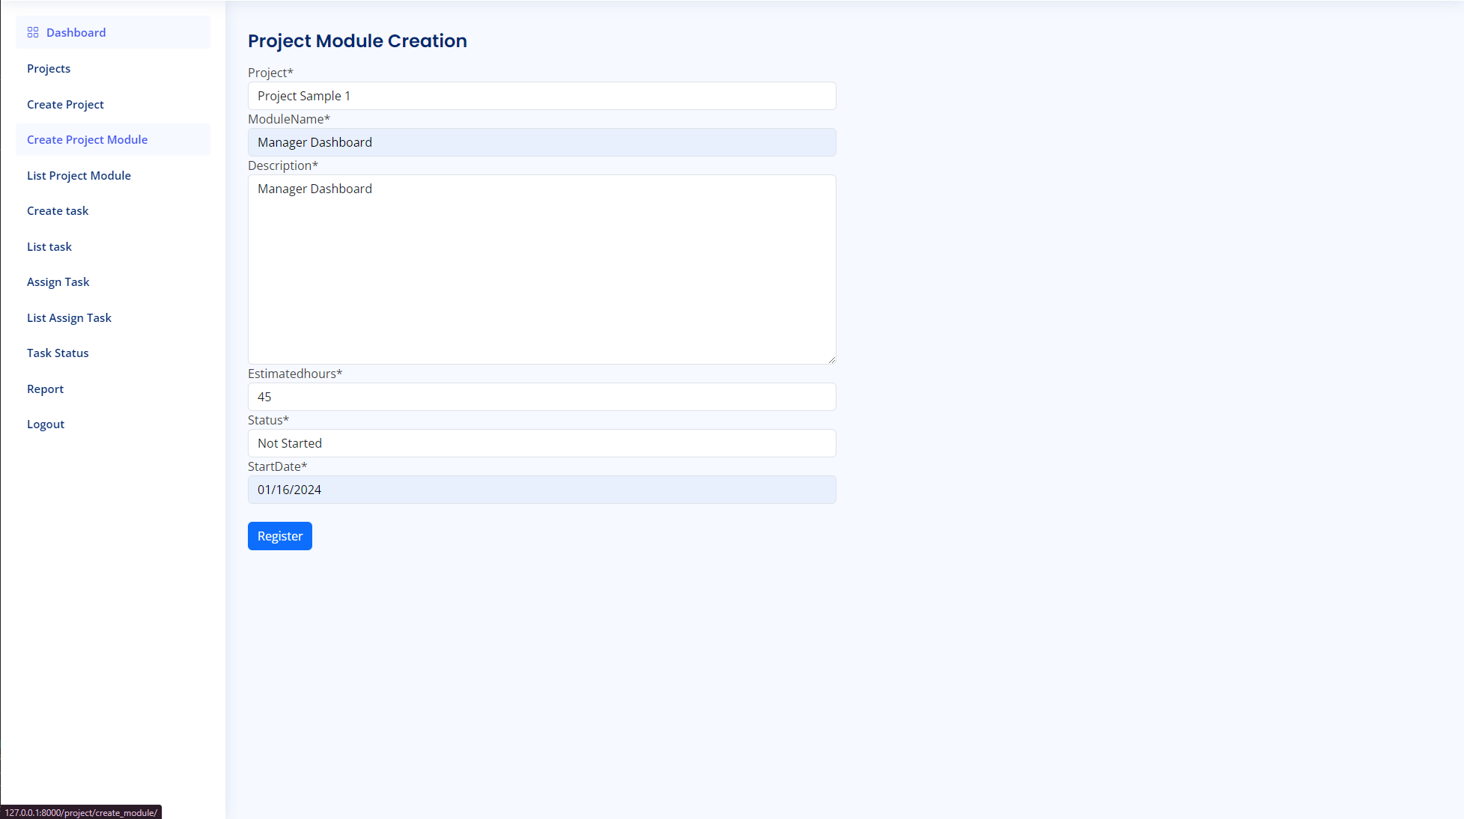
Project Module Creation

Slide 20
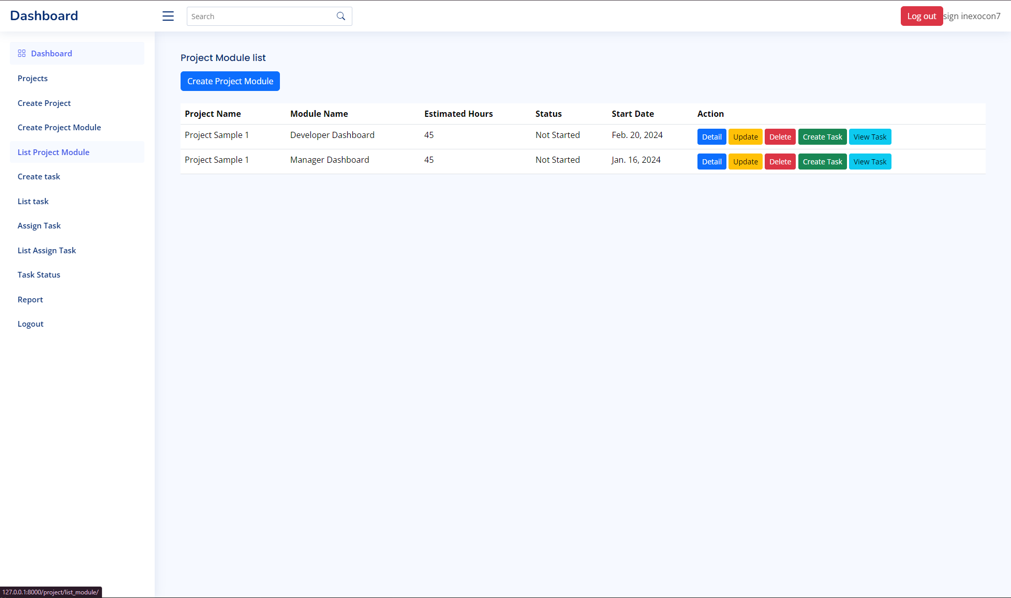
Project Module List

Slide 21
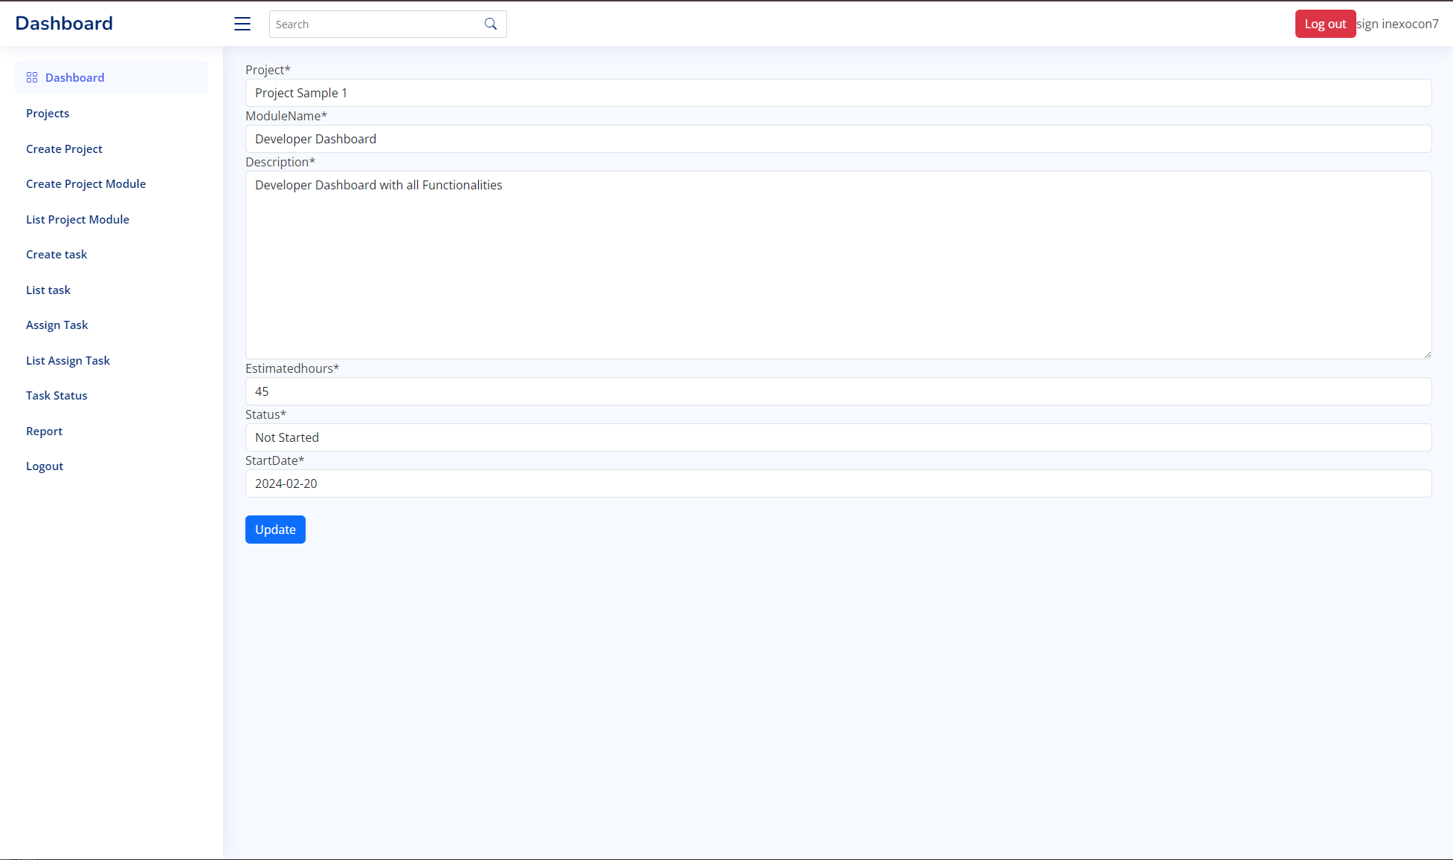
Update Project Module list

Slide 22
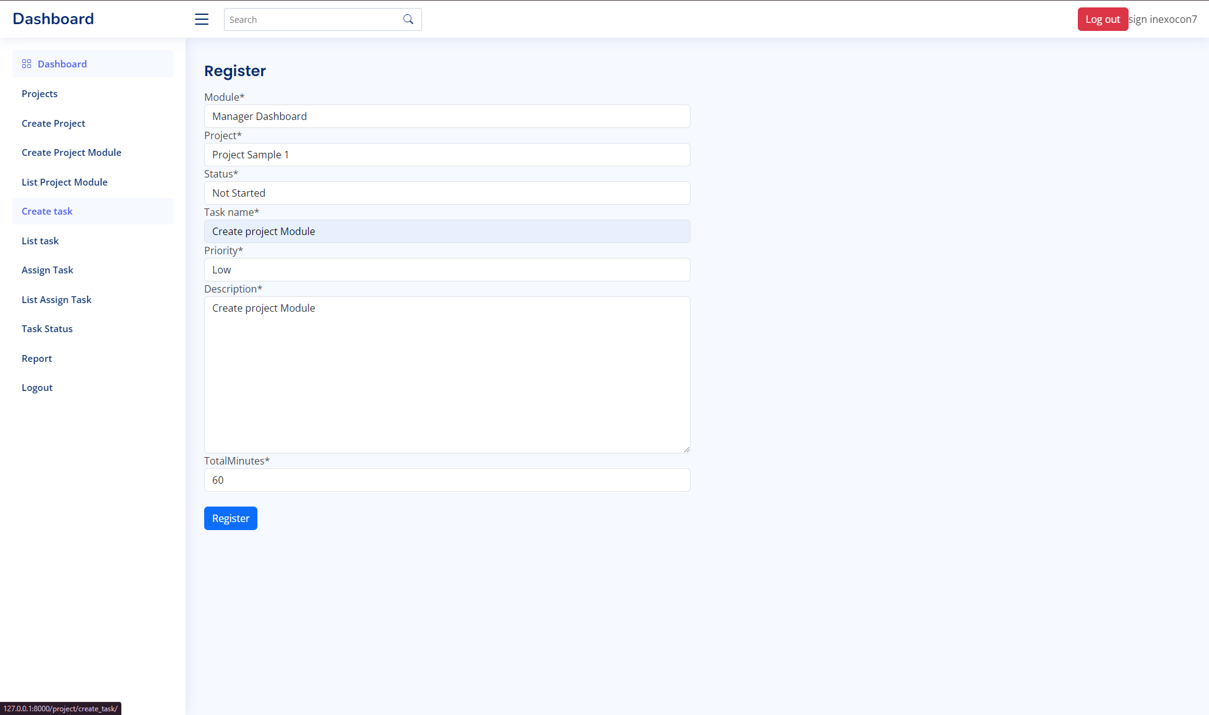
Task Creation Module

Slide 23
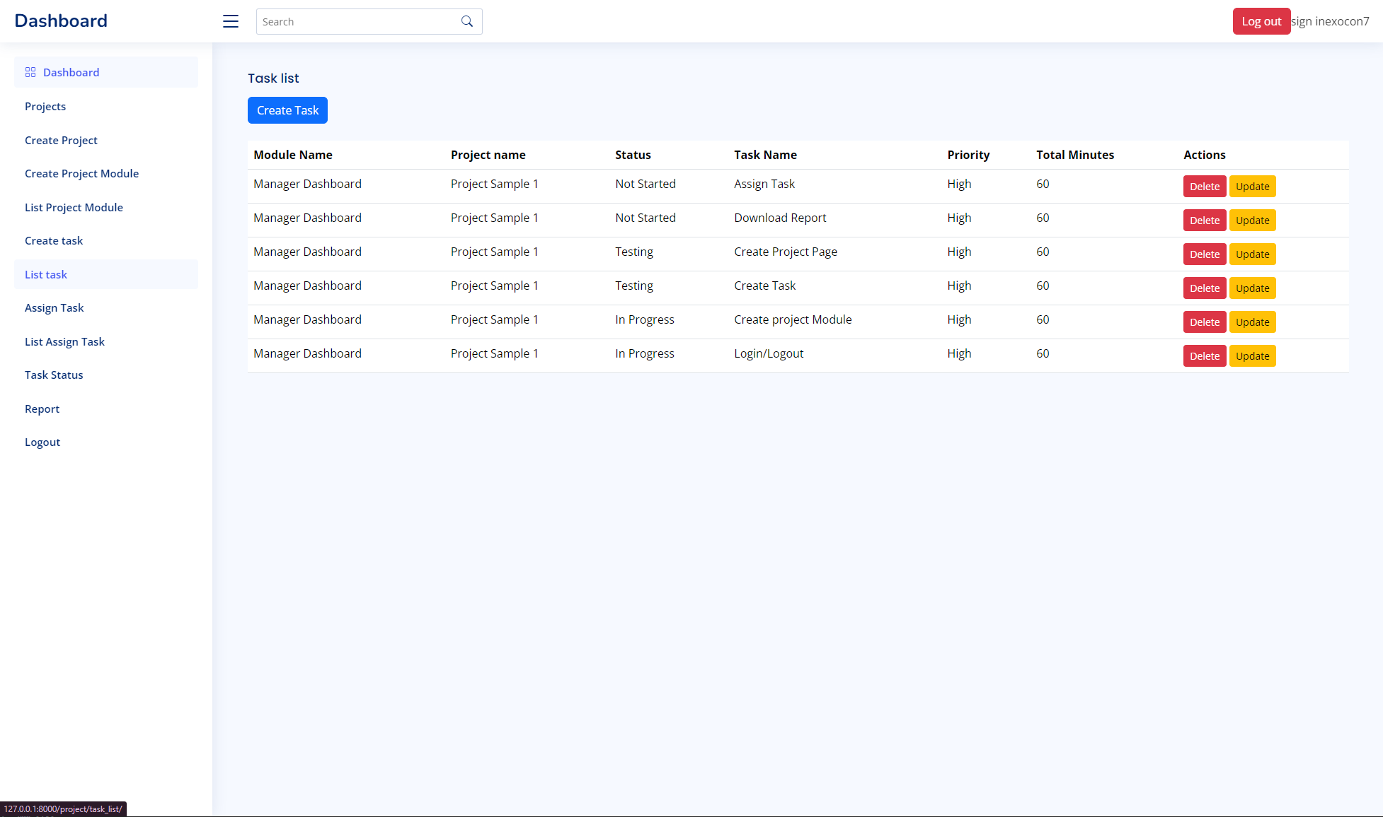
Task List

Slide 24
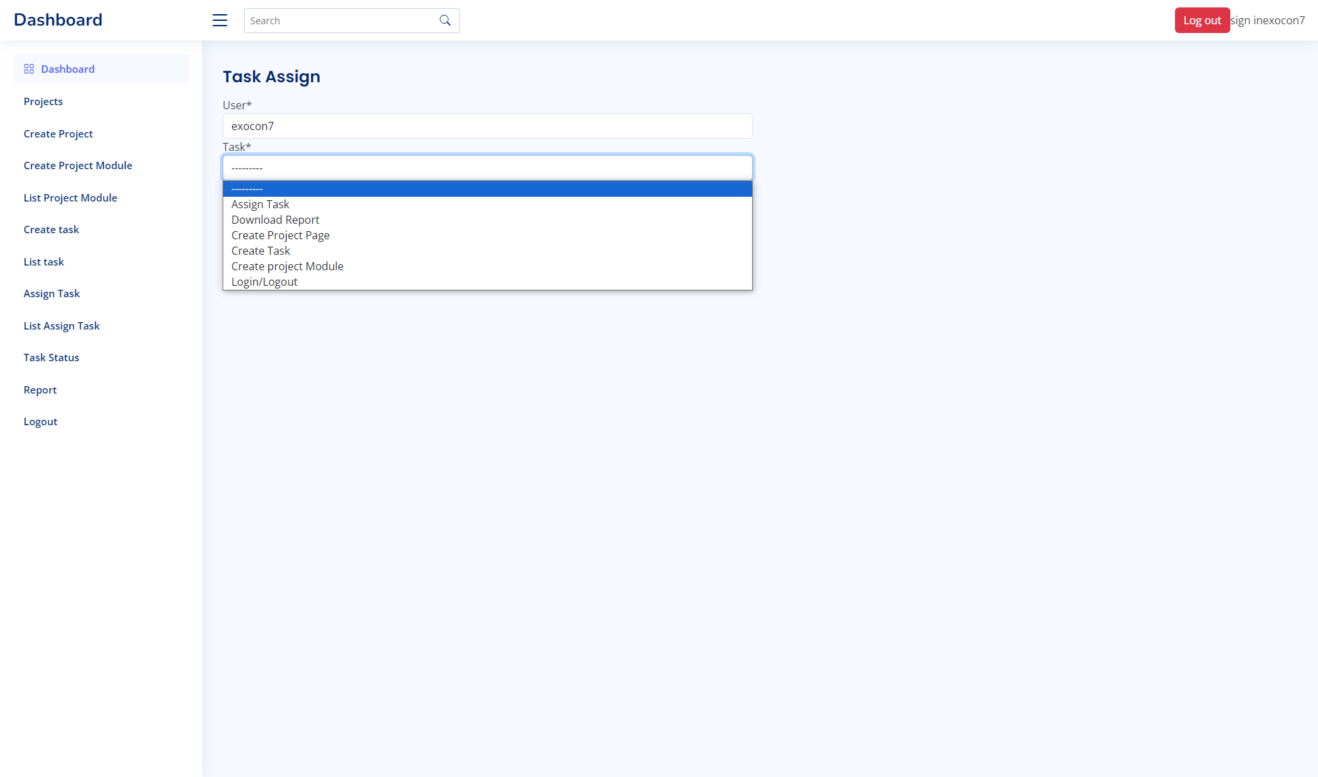
Task Assign

Slide 25
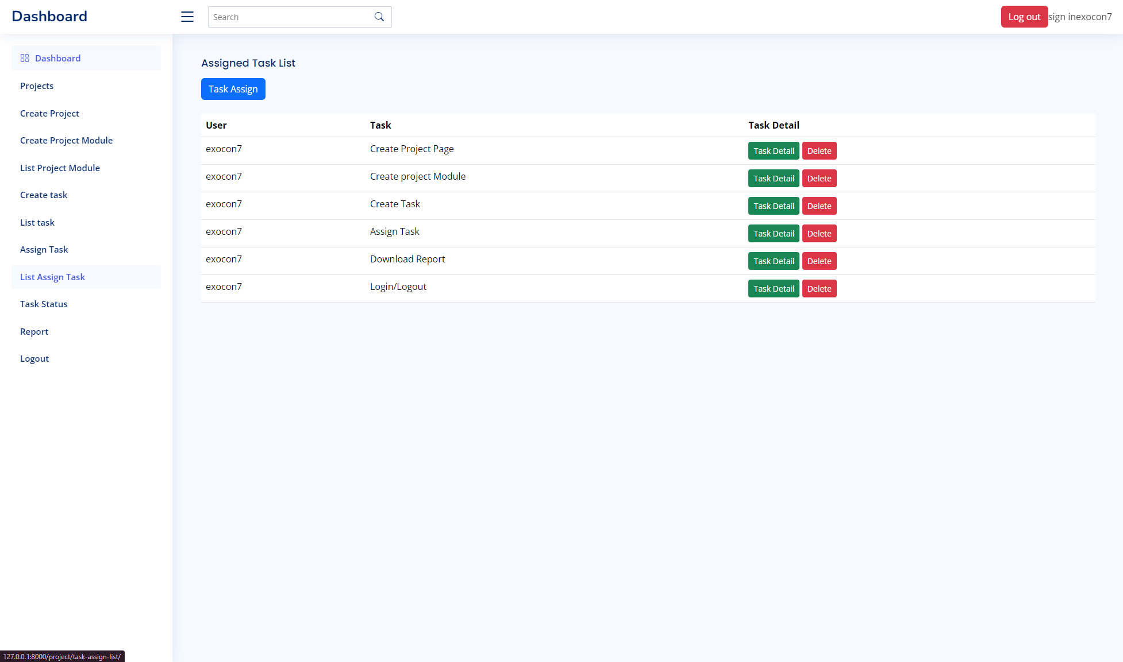
Assigned Task list

Slide 26
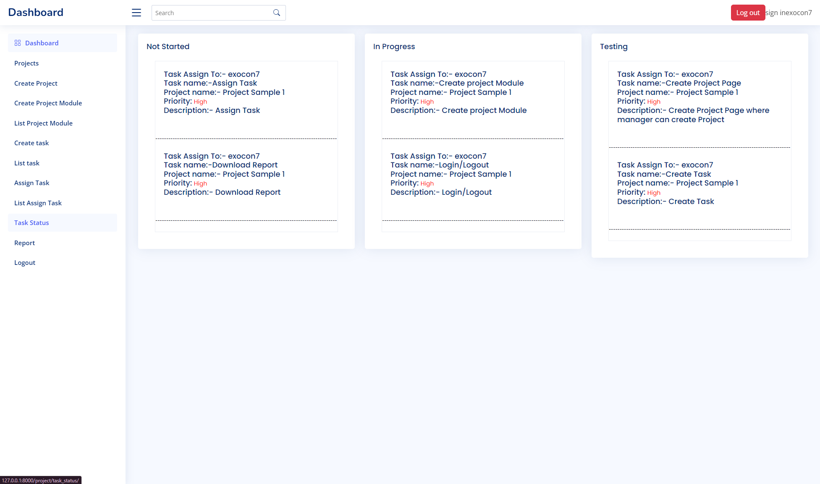
Task Status Module

Slide 27
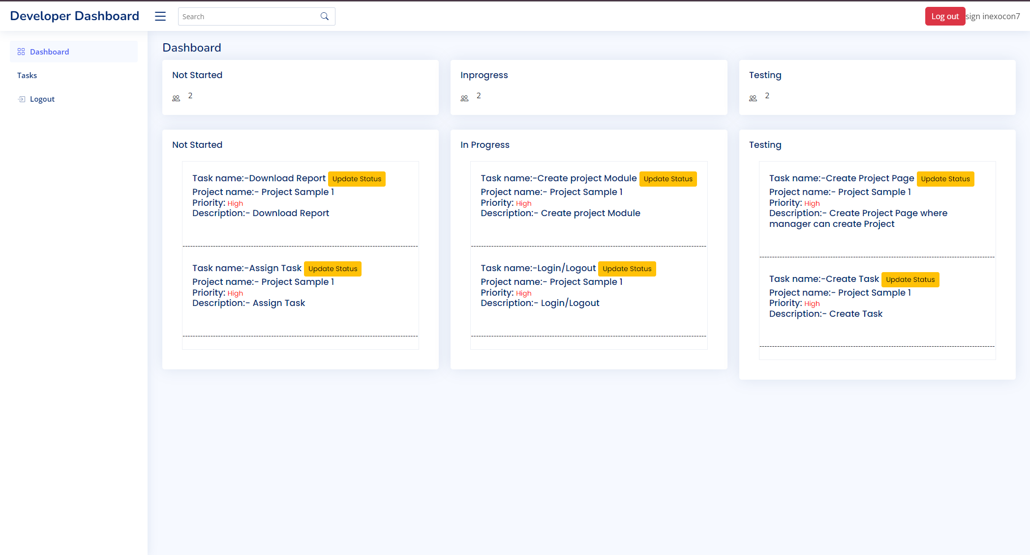
Developer Dashboard

Slide 28
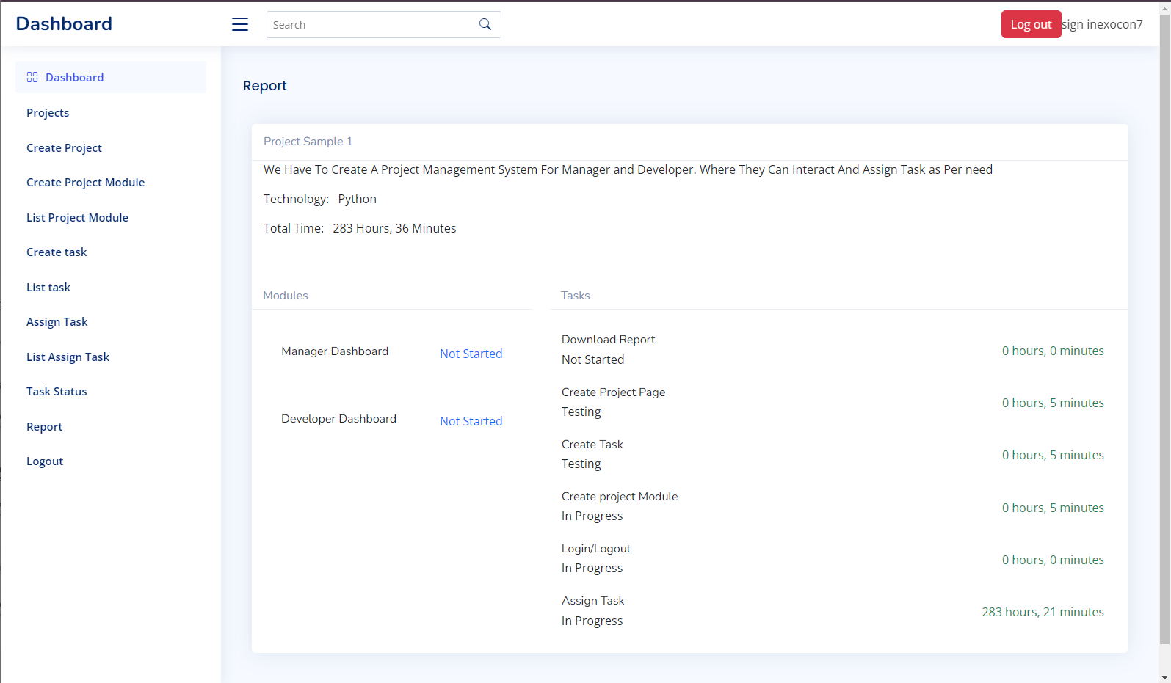
Report View

Slide 29
8. Conclusion
The 12-week internship project focusing on developing a project management web application using Python Django has been a significant learning experience. The application successfully bridges the gap between managers and developers, streamlining project workflows and enhancing collaboration. By creating a manager dashboard for project and task management, along with a developer dashboard for task tracking, the system promotes efficiency, transparency, and effective communication within the team. The project's adherence to best practices in web development, utilization of Django's robust features, and the implementation of a user-friendly interface contribute to a successful end product. The emphasis on creating a responsive design, efficient task allocation, and real-time task status updates aligns with industry standards and client expectations. The system's ability to meet company requirements and market demands underscores its value in improving project management processes.

Slide 30
Thank you

